Slide 1
What are you afraid of?
Examining belief in government agencies to protect against terrorism and trust in the honesty of the information they provide
Lat’Anna Davis and Stephanie Kern-Allely

Slide 2
!Background!
The catastrophic event of September 11, 2001 created unease tension for many US citizens
The act of terrorism was seen as a threat to national security, trust, and safety for all
With the repetitive act of terrorism US citizens placed trust in the government to protect against future life threating events
Fear of terrorism is a positive predictor of trust in the government for protection, driven by a need to seek support and security under significant threat of harm (Sinclair & LoCicero, 2010).
People tend to trust health and fire departments, including the CDC compared to other local, state, and federal government agencies (Kano et al, 2008)
Little work has been done to examine the association between how well people think the government can protect them from terrorism and whether they believe they are at risk or if they believe the information provided to them about terrorism by those agencies is honest.

Slide 3
!Research Question!
Do US citizens think that the information the local, state, and federal government provide about terrorism is honest?
Is there a association with whether they believe the government can protect them from future terrorist attacks?
Does it differ at local, state and federal levels?

Slide 4
!Layman’s Terms!
If you think the government is honest about terrorism then do you BELIEVE they can protect you from future terrorist attacks?

Slide 5
!Methods!

Slide 6


!Methods – Dataset!
National Survey of Disaster Experiences and Preparedness (NSDEP, N = 2,029)
National household telephone survey prepared by the National Consortium for the Study of Terrorism and Responses to Terrorism (START)
Interview administered in English or Spanish with gift incentives offered
Data collected in 2007-2008
Adult participants aged 18 and older

Slide 7
!Methods – Data Analysis!
Logistic regression: Estimate the odds of believing the government could protect from future terrorism based on trust in the government to be honest about terrorism. The association was also assessed across local, state, and federal levels of government.
Model 1 - Unadjusted model of bivariate association between believing the government could protect from future terrorism based on trust in the government to be honest about terrorism
Model 2 – Covariate adjusted model (Age, Education, Belief of information received, Perceived risk of terrorism)

Slide 8
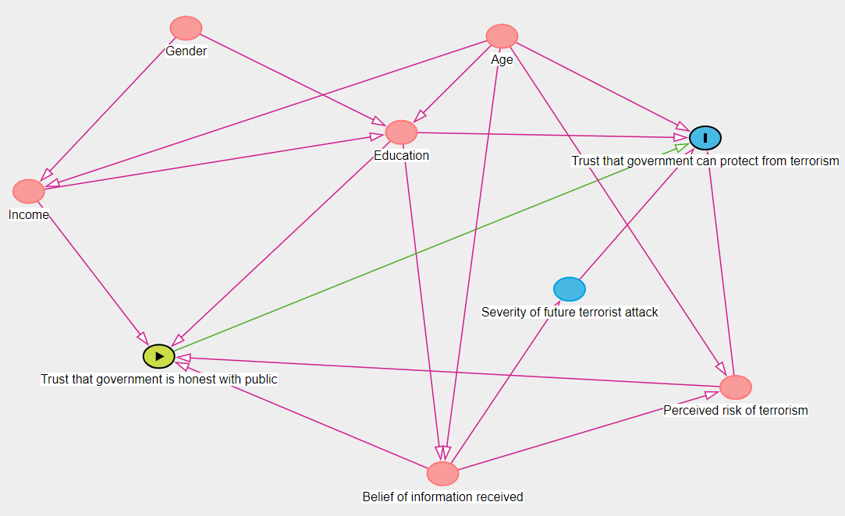
Proposed adjusted model: Trust that government can protect from terrorism = Trust that government is honest with public + Age + Education + Belief of information received + Perceived risk of terrorism

Slide 9
!Methods – Data Analysis!
Local
Trust that government is honest with public about terrorism
State
Trust that government can protect from terrorism
Federal
Age + Education + Belief of information received + Perceived risk of terrorism

Slide 10
!Methods – Variables!
Trust that government can protect from terrorism – Perceived effectiveness
“How sure are you that < ... > could effectively protect you from a future terrorist attack? Would you say ‘1, not at all sure,’ ‘5, extremely sure,’ or you may use any number in between?”
Levels of government: Local government, State government, Federal government
Trust that government is honest with public – Perceived honesty of information about terrorism received by social distance, indicated by level of government
“In your opinion, how honest with the public would you say the < ... > is about terrorism? Would you say ‘1, never honest,’ ‘5, always honest,’ or you may use any number in between?”
Levels of government:
Local: Mayor, Local Fire Department, Local Police Department, County/City Health Department
State: Governor, State Office of Emergency Services, State Health Department
Federal: President of the United States, Department of Homeland Security, Centers for Disease Control, Federal Emergency Management Agency
Notes:
Perceived honesty of information sources is negatively associated with the social distance of the recipient from the source, where social distance is determined by whether agencies and officials are local, state or federal.

Slide 11
!Methods – Variables!
Belief of information received
“How much of the information that you heard about protecting yourself from terrorism since September 11th, 2001, did you believe? Would you say ‘1, did not believe any of it,’ ‘5, believed all of it,’ or you may use any number in between?”
Perceived risk of terrorism
“How likely is it that a terrorism event like an explosion, biological, chemical, or radiological agents being released in your community will occur in your lifetime? Would you say ‘1, not at all likely,’ ‘5, definitely will occur,’ or any number in between?”

Slide 12
!Results!

Slide 13
!Results!
 | Not trust government protection (n=1741) n (%) | Trust government protection (n=288) n (%)
Education
High school diploma/GED | 546 (31.4%) | 103 (35.8%)
Junior college degree | 160 (9.2%) | 30 (10.4%)
Bachelors degree | 403 (23.1%) | 53 (18.4%)
Post-graduate degree | 330 (19%) | 27 (9.3%)
None/Other | 305 (17.4%) | 75 (26.1%)
Belief of information received
1 - Did not believe any of it | 102 (5.9%) | 6 (2.1%)
2 | 294 (16.9%) | 16 (5.6%)
3 | 738 (42.4%) | 74 (25.7%)
4 | 395 (22.7%) | 102 (35.4%)
5 - Believed all of it | 212 (12.2%) | 90 (31.2%)
Perceived risk of terrorism
1 - Not at all likely | 521 (29.9%) | 97 (33.7%)
2 | 416 (23.9%) | 52 (18.1%)
3 | 370 (21.3%) | 71 (24.7%)
4 | 182 (10.5%) | 30 (10.4%)
5 - Definitely will occur | 252 (14.5%) | 38 (13.2%)
Table 1. Characteristics of participants who do or do not trust that government can protect from terrorism
Age
(Median [Range])
Not trust government protection: 50 [18-98]
Trust government protection: 46 [18-88]

Slide 14
 | Model 1 OR (95% CI) | Model 2 OR (95% CI)
All government trust | 25.29 (14.38-44.46) | 23.15 (12.97-41.33)

Slide 15
 | Model 1 OR (95% CI) | Model 2 OR (95% CI)
Local government trust | 6.05 (4.14-8.83) | 5.77 (3.88-8.57)
State government trust | 5.66 (4.21-7.59) | 5.60(4.09-7.67)
Federal government trust | 5.33(4.30-6.61) | 4.56(3.62-5.73)

Slide 16
!Discussion!
Conclusion
The magnitude of association between trust in honesty of information and belief in protection was higher as social distance decreased. The findings suggest that local government should be considered as a key communication avenue for effective emergency response to a terrorist attack.
Strengths/Limitations
Further Direction
Further research on whether the influence of protection differ for local, state, and federal government levels
Examine relation at multiple government levels Uses nationally representative sample Adjusted for other important emergency preparedness constructs | Categorization amongst local, state, and federal officials are not measured the same Not all levels of government have the same official roles Loss of variation due to collapsing categories Selection bias due to missing information

